Slide 1


Lara Petričević
Magdalena Lasić
Viktorija Grabovac
Ivano Blažević
Mirko Grabovac
November/ December 2023
DOING GOOD TOGETHER

Slide 2

November/December 2023
Sunday | Monday | Tuesday | Wednesday | Thursday | Friday | Saturday
26 | 27 | 28 Lara collected rubbish on Prološko Blato Lake | 29 | 30 | 1 Magdalena planted onions and broad beans in her garden | 2
3 | 4 Viktorija made cakes for her old neighbours | 5 | 6 | 7 Ivano bought some fruit and vegetables for an immobile person | 8 | 9
10 | 11 | 12 Mirko donated old clothes to the Red Cross | 13 | 14 | 15 | 16
17 | 18 | 19 | 20 | 21 | 22 | 23
24 | 25 | 26 | 27 | 28 | 29 | 30
31
on November 28th: Lara collected rubbish on Prološko Blato Lake
on December 1st: Magdalena planted onions and broad beans in her garden
on December 4th: Viktorija made cakes for her old neighbours
on December 7th: Ivano bought some fruit and vegetables for an immobile person
on December 12th: Mirko donated old clothes to the Red Cross

Slide 3
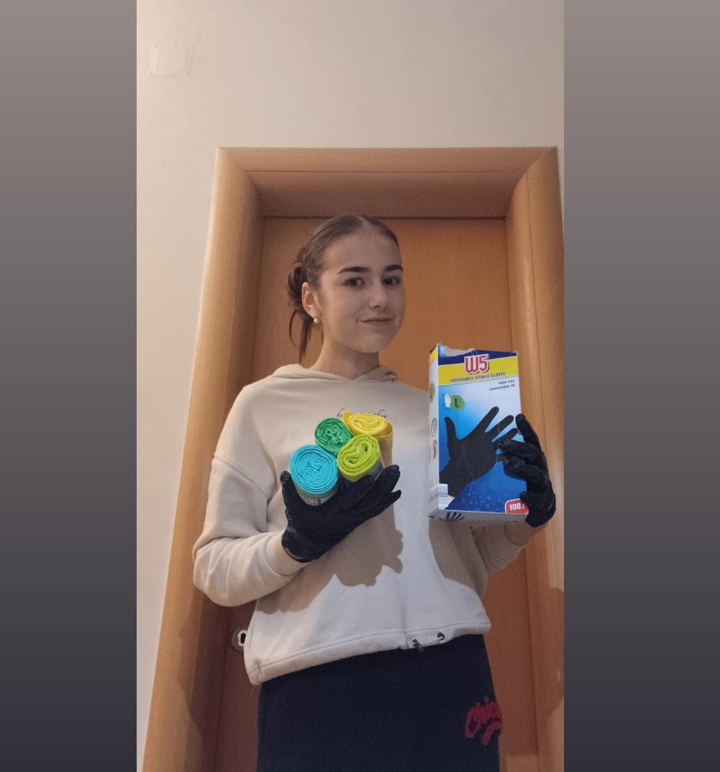
Lara Petričević
LARA COLLECTED RUBBISH ON PROLOŠKO BLATO LAKE
Lara cycled to Prološko Blato Lake.
She took gloves and rubbish bags.
She collected rubbish.
She sorted it out (paper, plastic, glass bottles, cans…) and put it into different bags.
She took it to different containers.

Slide 4
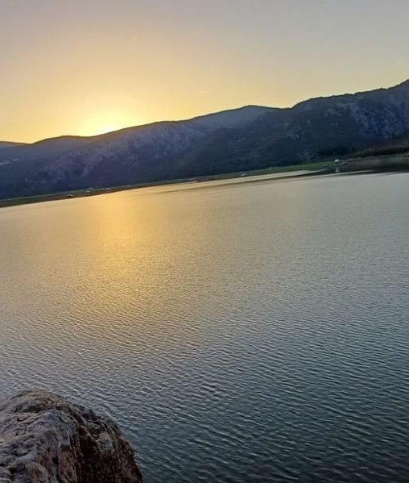
Lara Petričević
LARA COLLECTED RUBBISH ON PROLOŠKO BLATO LAKE
She was tired during the process of collecting rubbish.
She was very proud after finishing it.
That was good for our nature.
Lara is eco-friendly.

Slide 5

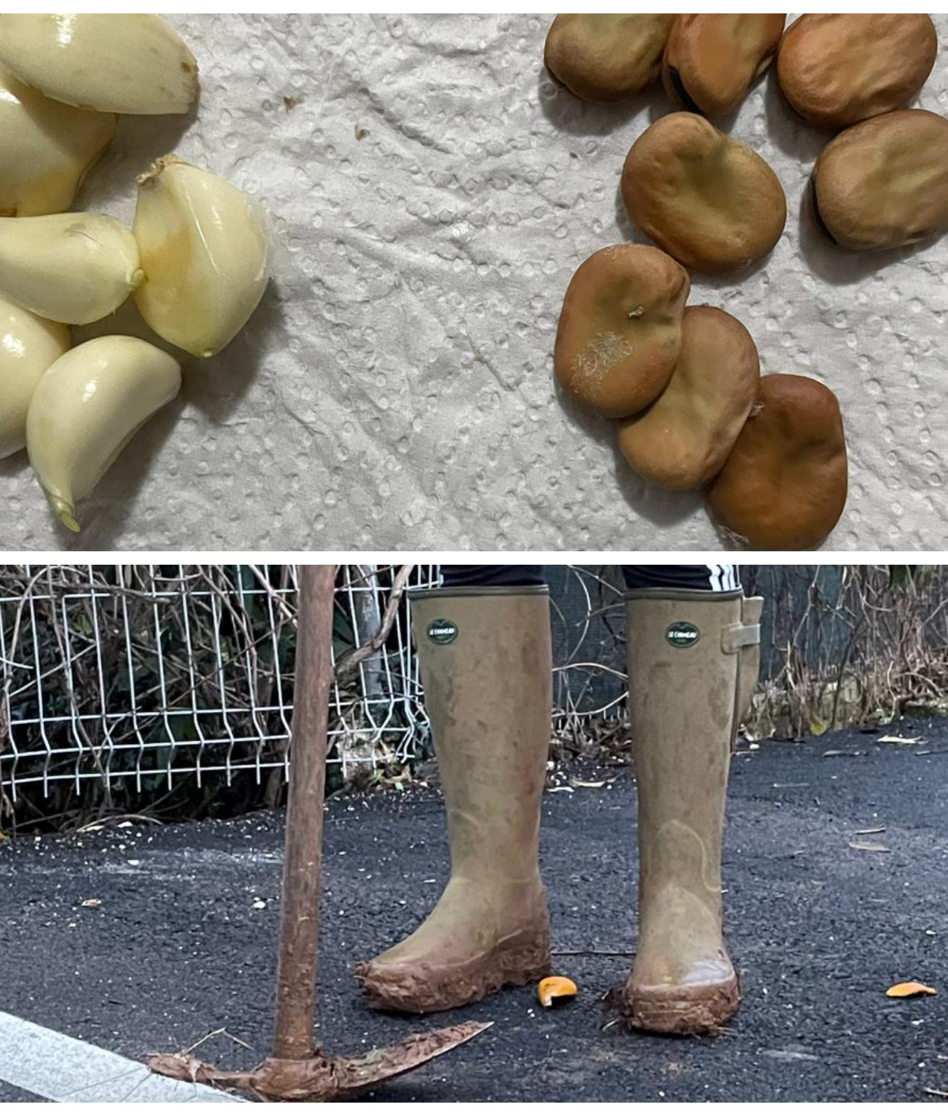
Magdalena Lasić
MAGDALENA PLANTED ONIONS AND BROAD BEANS IN HER GARDEN
Magdalena bought the seed.
The soil was already prepared.
She used a hoe to make rows for planting.
She put some fertilizer.
She planted the onions and broad beans.

Slide 6
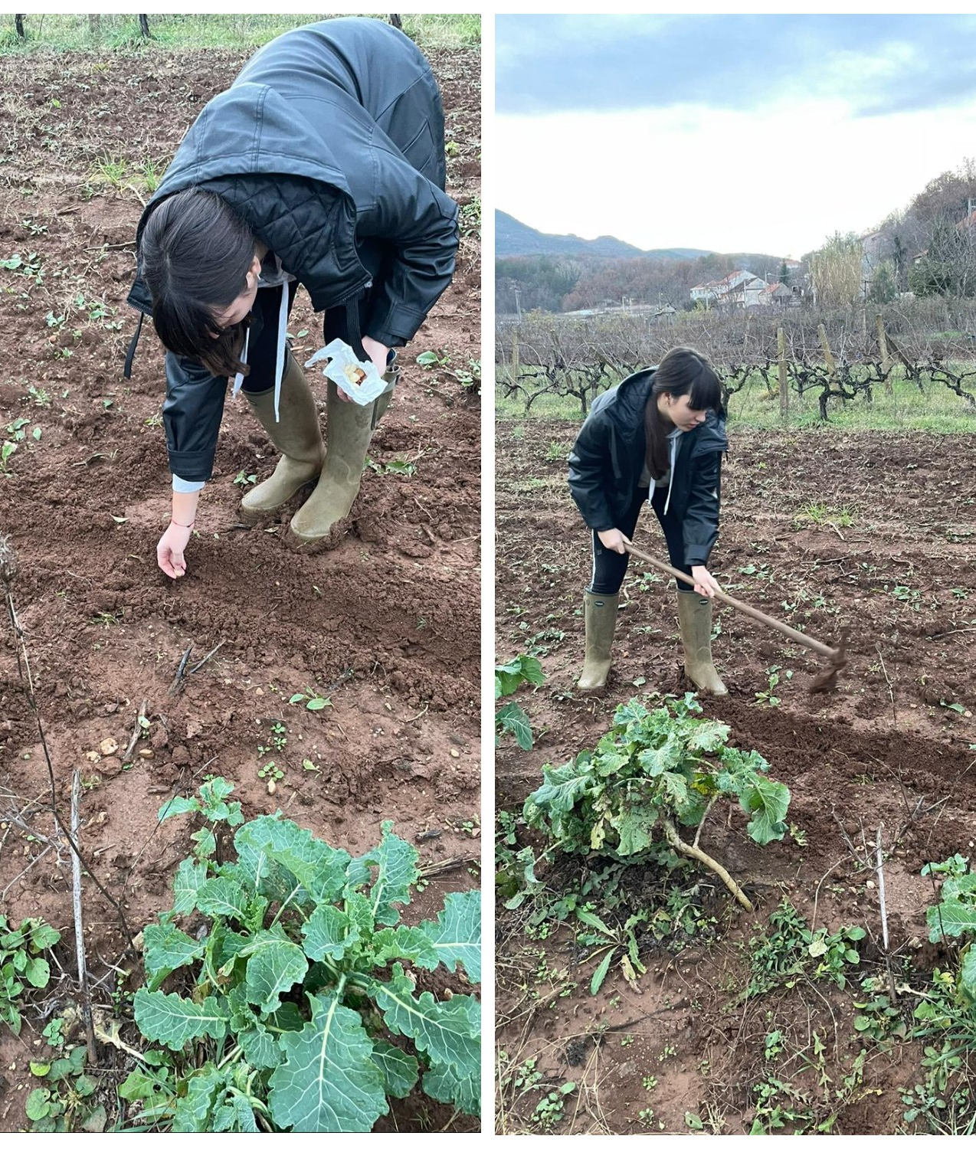
Magdalena Lasić
MAGDALENA PLANTED ONIONS AND BROAD BEANS IN HER GARDEN
She felt useful while planting.
She felt hapy about it.
She spent some time outside. It is better and healthier than playing games on the phone.
She and her family will eat eco food, produced without pesticides.

Slide 7
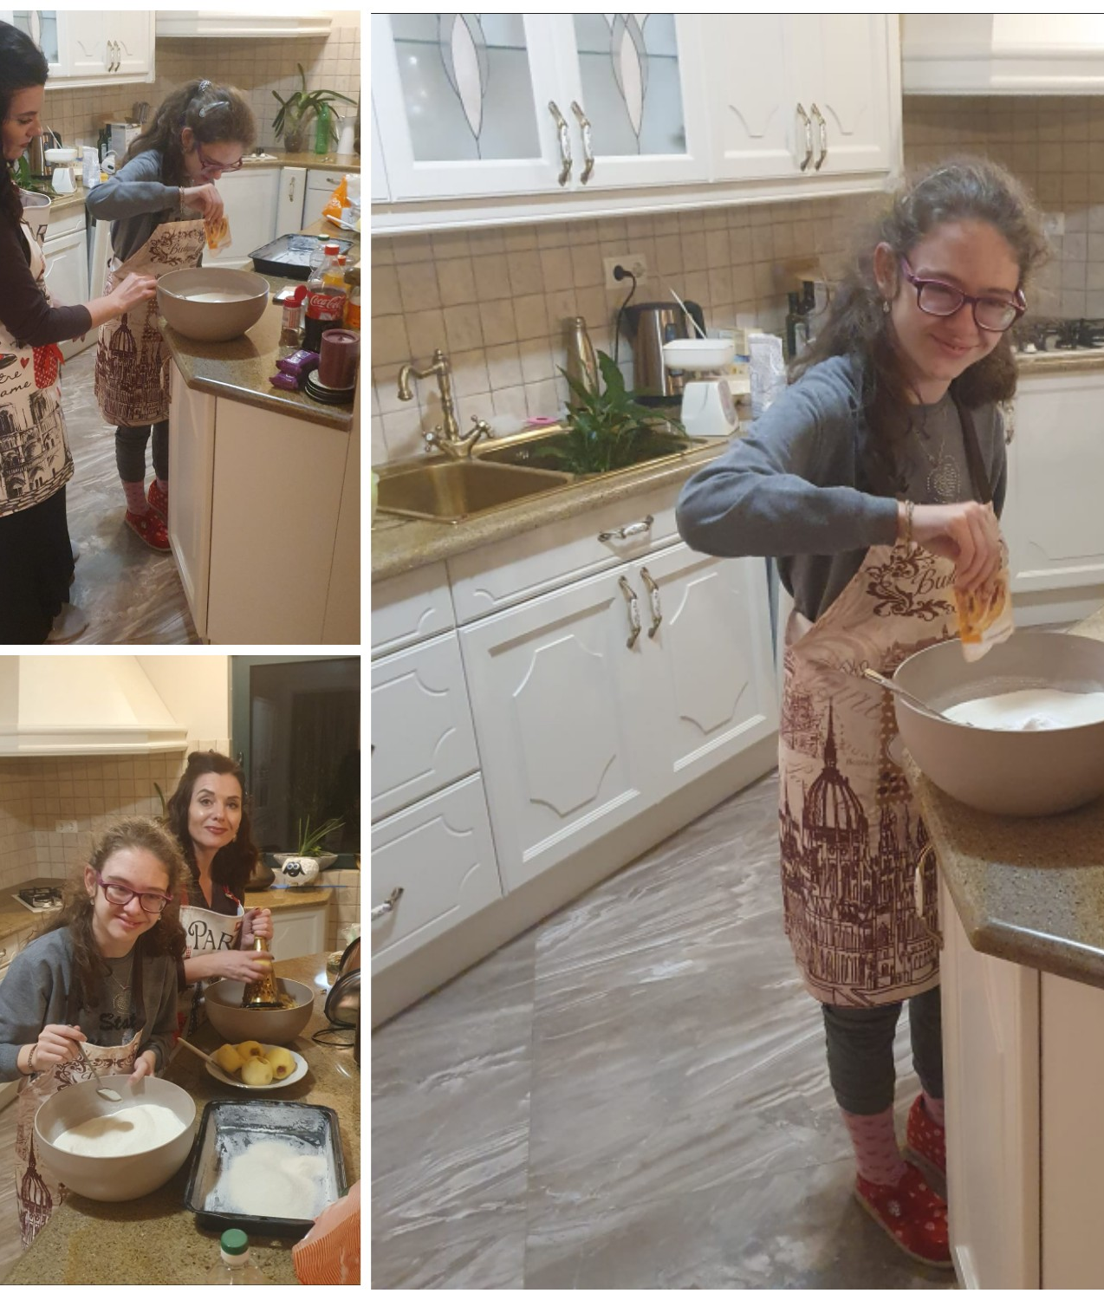
Viktorija Grabovac
VIKTORIJA MADE CAKES FOR HER OLD NEIGHBOURS
Viktorija wanted to do something good for her old neighbours.
She decided to make cakes for them.
She bought some ingredients.
Her mum helped her.
They prepared an Apple pie and a Chocolate cake.
She decorated them and brought them to the old ladies.

Slide 8
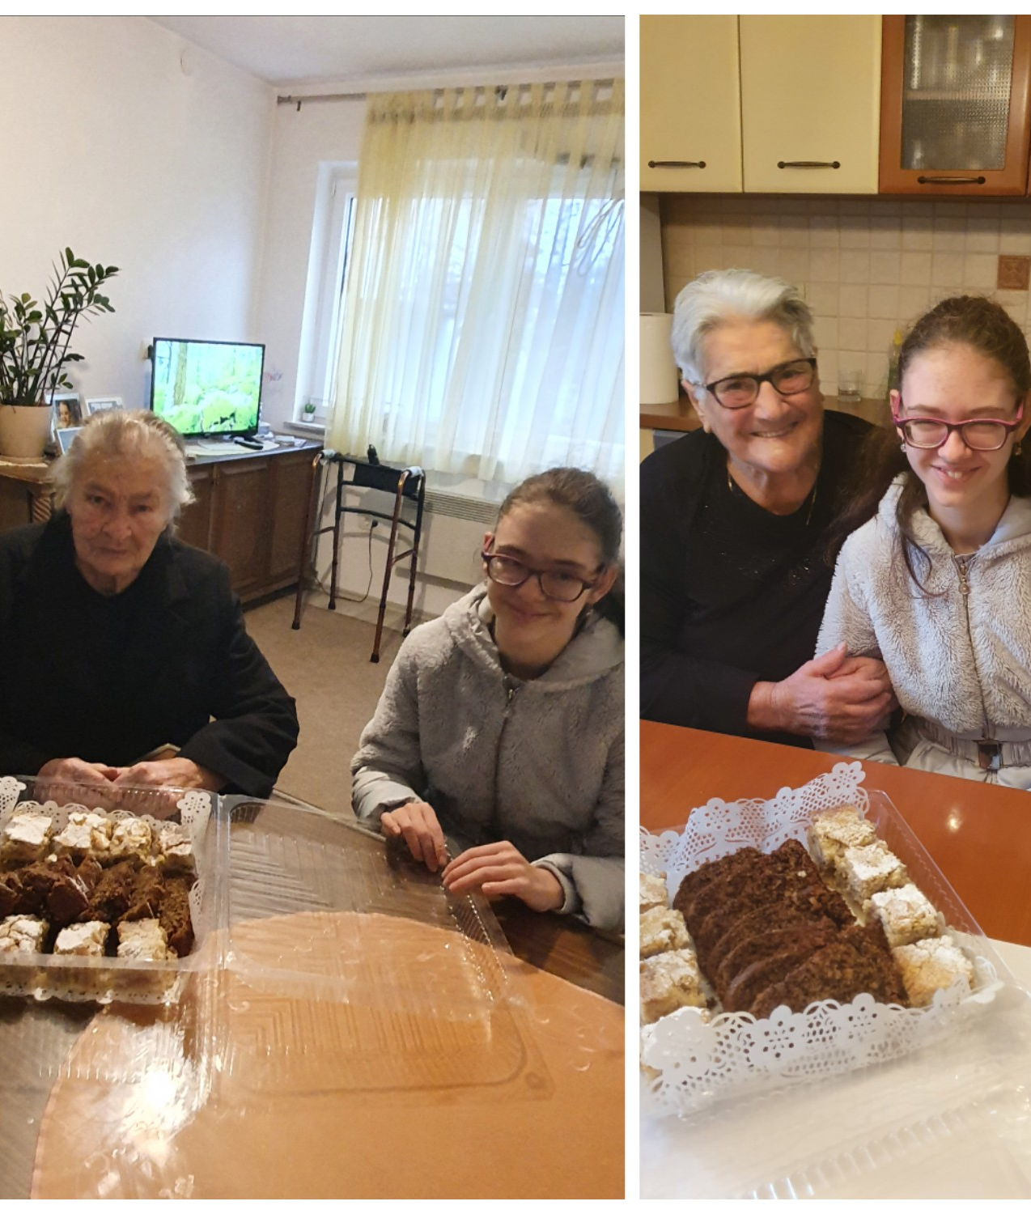
Viktorija Grabovac
VIKTORIJA MADE CAKES FOR HER OLD NEIGHBOURS
They took some photos together.
The old ladies were very thankful.
Viktorija felt happy and proud of herself.
She likes helping other people.

Slide 9
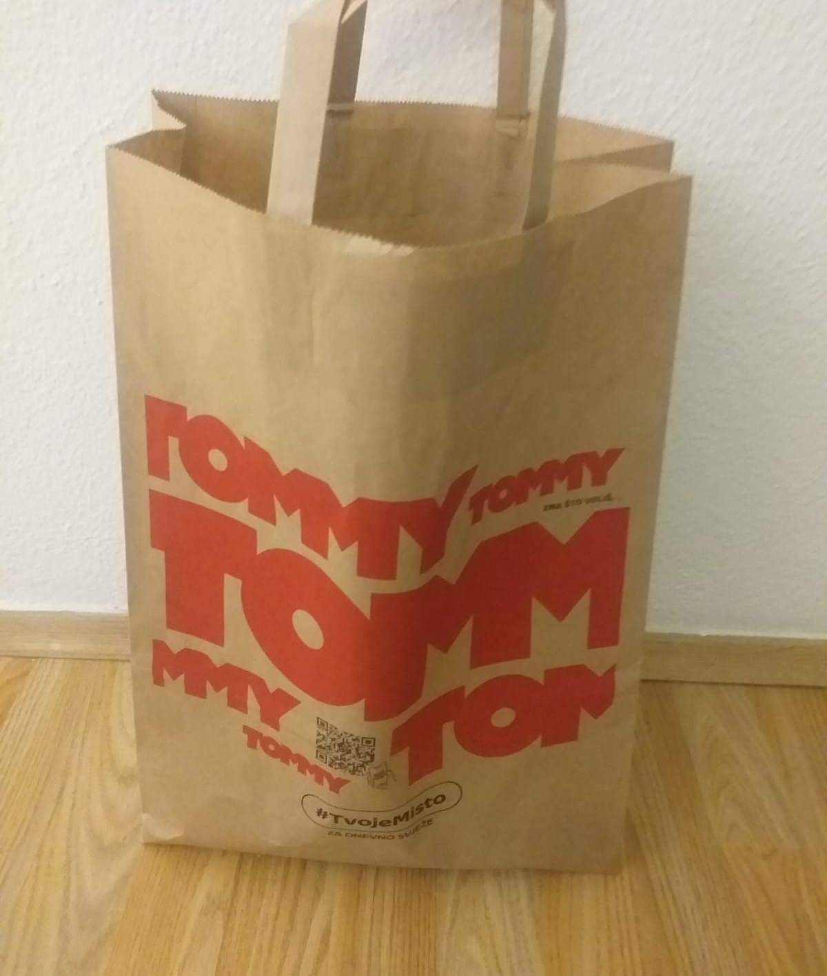
Ivano Blažević
IVANO BOUGHT SOME FRUIT AND VEGETABLES FOR AN IMMOBILE PERSON
Ivano went to the shop.
He bought some fruit (tangerines, apples, oranges…).
He bought some vegetables (cabbage, cauliflower…).
He bought some other groceries.
He took it to his old immobile neighbour.

Slide 10
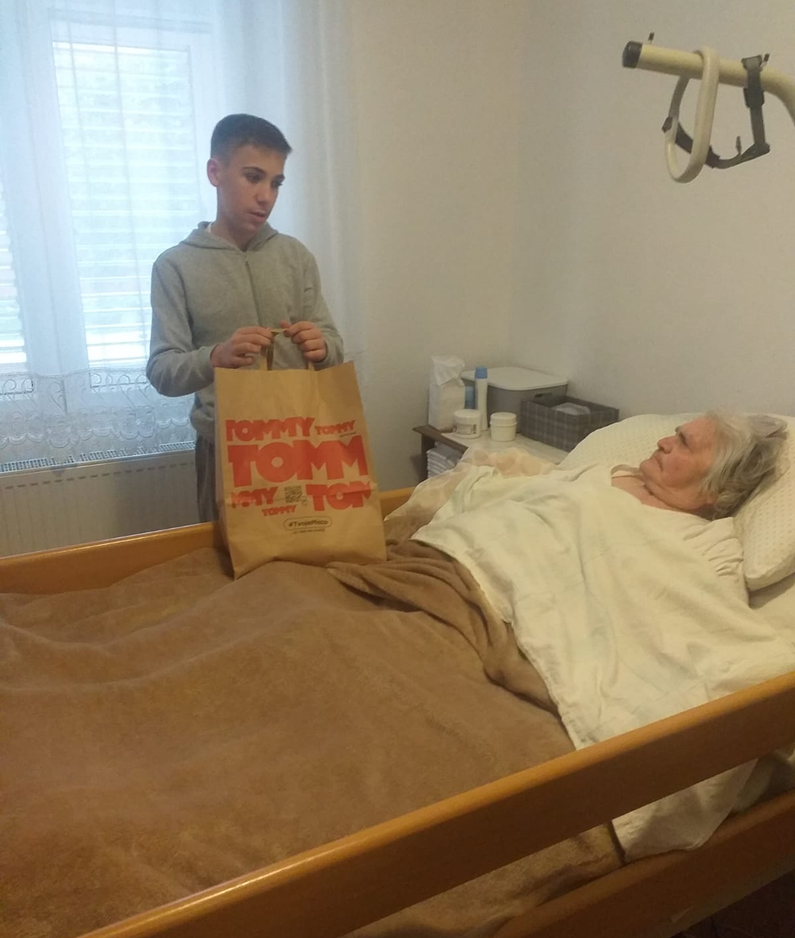
Ivano Blažević
IVANO BOUGHT SOME FRUIT AND VEGETABLES FOR AN IMMOBILE PERSON
The neighbour was very happy.
Ivano was fulfilled and proud of himself.
He likes doing good.

Slide 11
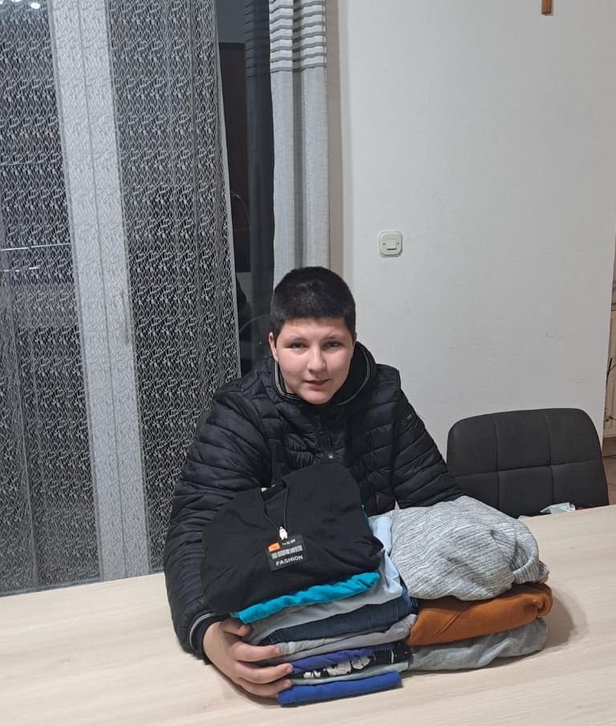
Mirko Grabovac
MIRKO DONATED OLD CLOTHES TO THE RED CROSS
Mirko collected some old, but usable clothes for children and adults.
His mum helped him to sort it out.
She drove him to town.
He put it into the Red Cross container for people in need.

Slide 12
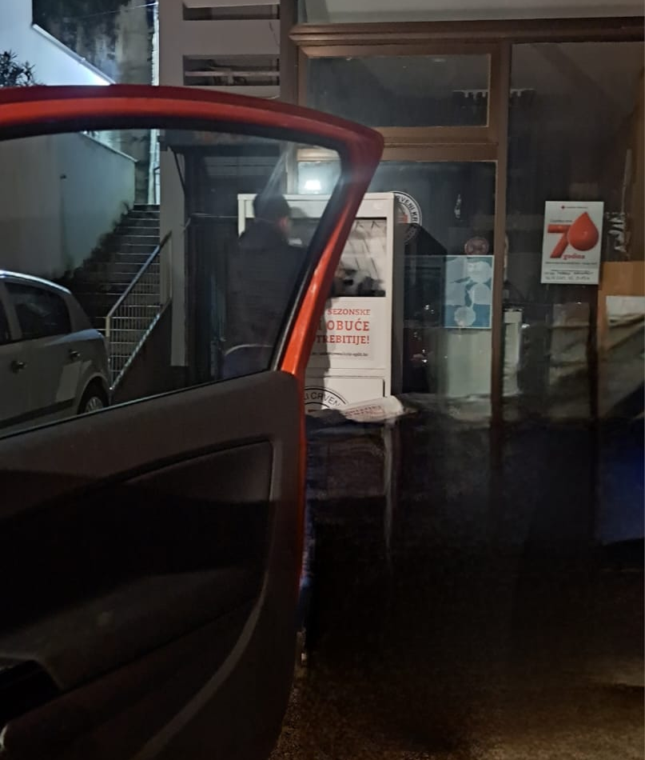
Mirko Grabovac
MIRKO DONATED OLD CLOTHES TO THE RED CROSS
Mirko felt happy and proud.
He is a good person.
He likes helping others.

Slide 13
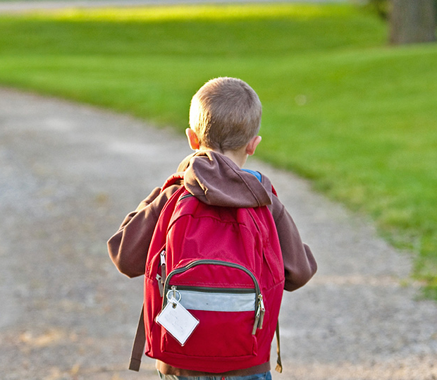
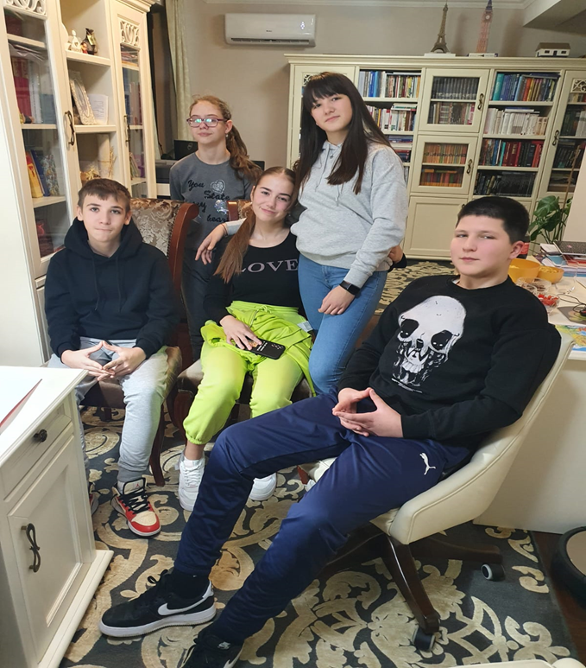


Thank you for your attention!
Bye!

