Slide 1
Proložac
Petra, Petar, Goran, Hana

Slide 2
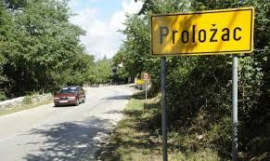
Life in the past
the area of Proložac is inhabited since prehistoric times
the Illyrian tribe Delmati were the first known people to mark this area
people were very poor
they worked really hard for cheap life

Slide 3
Families in the past
-They had a lot of children because they needed help in their household and agriculture
most of families had fields
worked every day except on Sundays because most of people were catholics

Slide 4
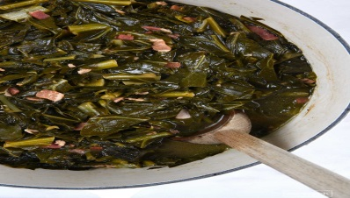
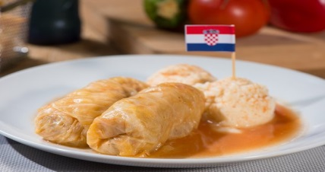
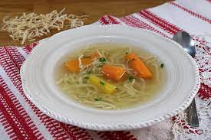
Food in the past
greens- green leafy vegetables ,edible plant leaves
sarma-traditional dish ,made of sauerkraut-leaves of fermented cabbage,which becomes sour when bacteria cause fermentation of its sugars.
soup-liquid dish usually made of meat,bones,fish,vegetables ,etc.
h

Slide 5
Life before vs today
everyone has the right to education
there are many jobs
most of people are financially stable
people have better vehicles
not everyone had the right for education
there was a small amount of jobs
bigger amount of people were not financially stable
people did not have a lot of vehicles

Slide 6
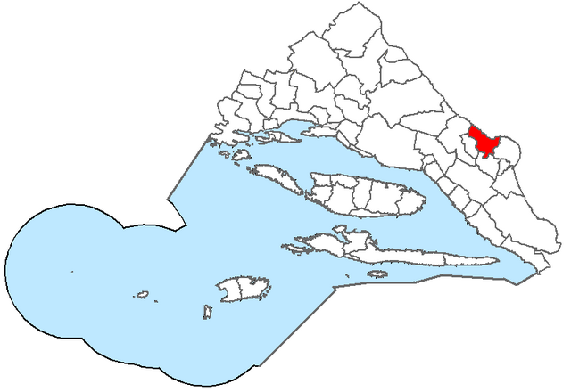
Life today
Proložac is municipality today
it has around 3000 people according to year 2011
it is in Split-Dalmatian county
the chief is Mate Lasić
people are usually catholics

Slide 7
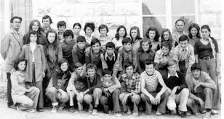
School life in the past
small amount of people was educated
some of them had only 3 grades
there was not university or college

Slide 8
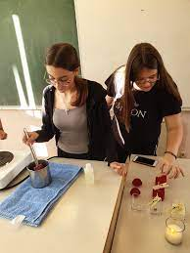
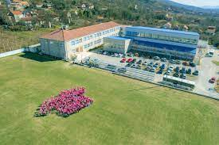
School life today
almost everyone is educated today
people have to learn much more than before
there are more subject areas now

Slide 9
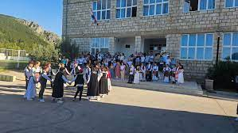
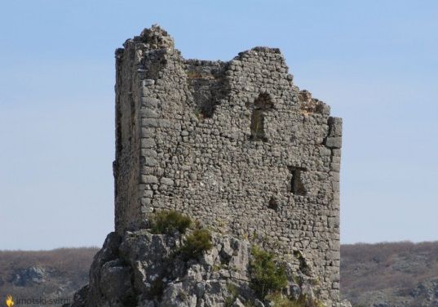
Arts and crafts
Imotsko kolo-traditional dance
Churches-building used for religious activities
Turska kula-the tower built by the Turks in war
Statues of saints-sculpt/statues of saint people

Slide 10
Thanks for watching! :D
Hana,petar,petra,goran

